Slide 1
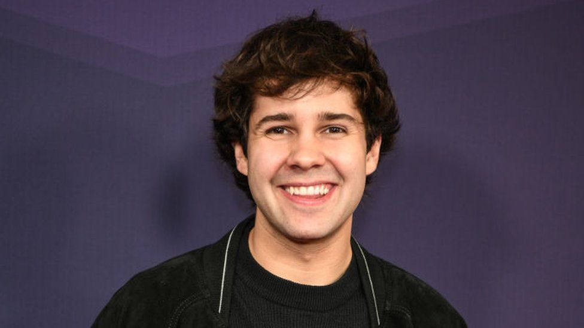
DAVID DOBRIK
NGUYỄN HOÀNG GIANG
ITITIU21192

Slide 2
Table of contents
01
02
03
BACKGROUND
ACHIEVEMENT
CONTRIBUTIONS

Slide 3
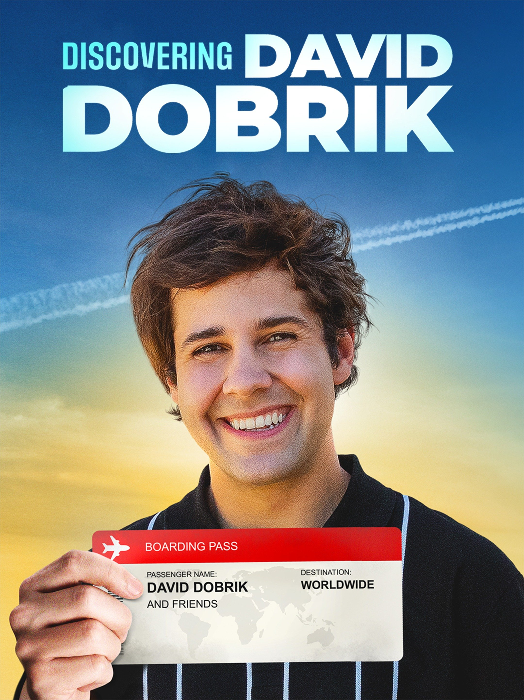
01
BACKGROUND

Slide 4
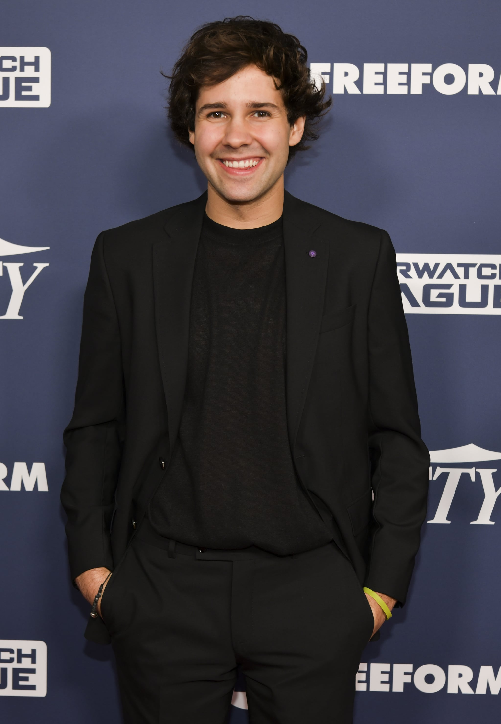
PERSONAL INFORMATION.
Name | David Dobrik.
Occupation | Youtuber, Tiktoker.
Location | Los Angeles, California, U.S.
Born | July 23, 1996 (age 26), Slovakia.
Nationality | American-Slovak.

Slide 5
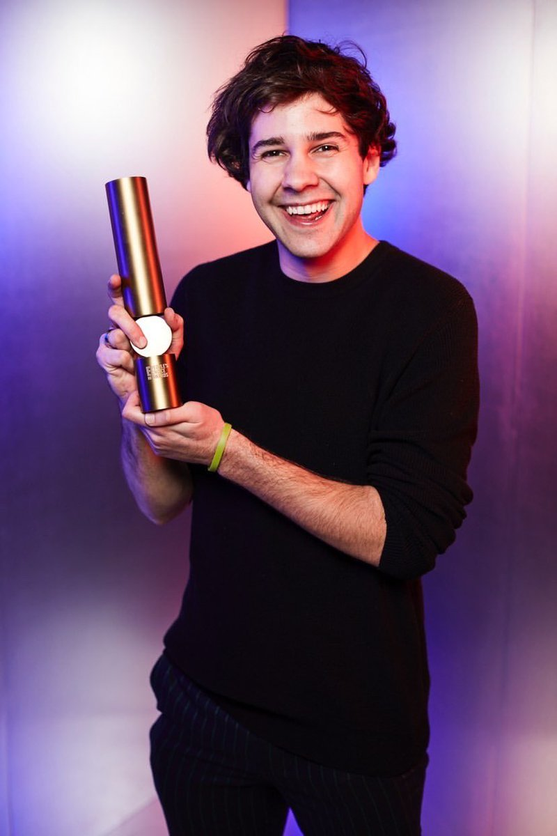
02
ACHIeVEMENT

Slide 6
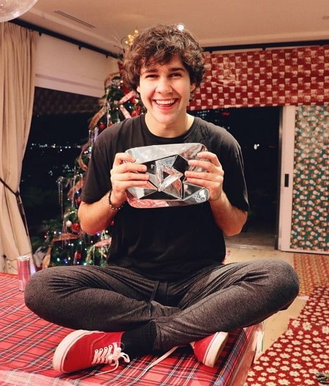
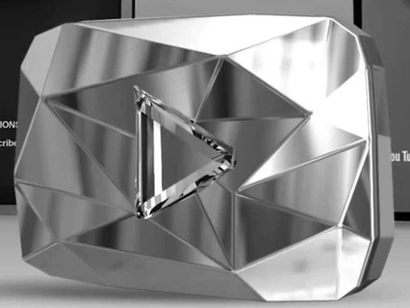
2018
Diamond Play Button
( )

Slide 7
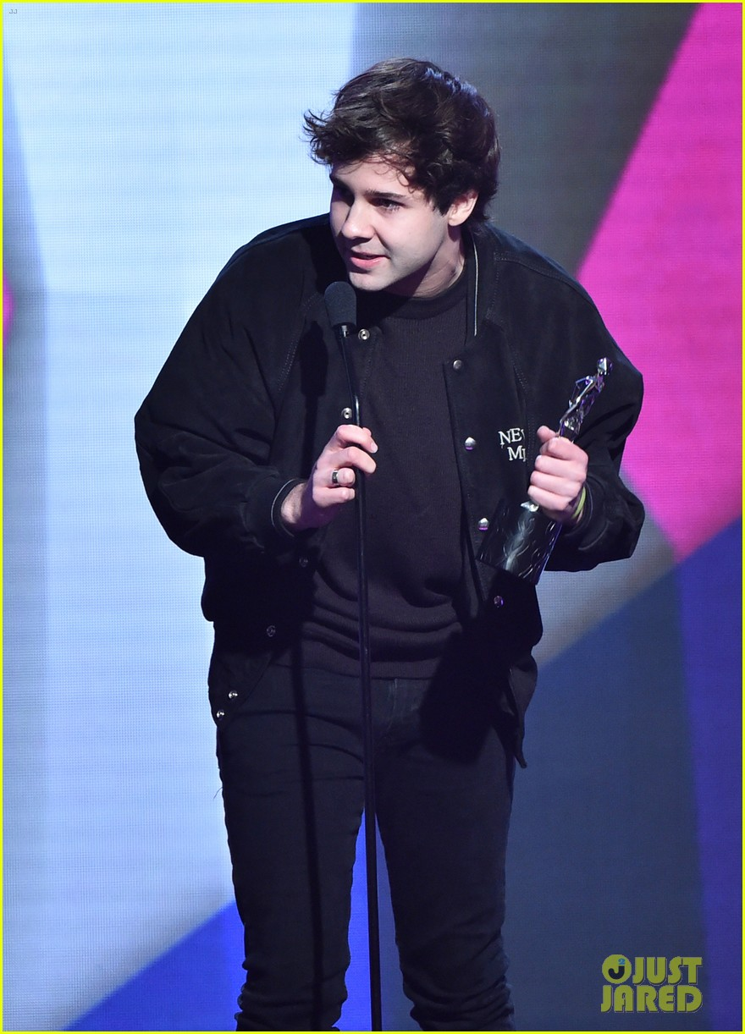
2017-2020
1.Shorty Award
2.Streamy Award
3.Teen’s Choice Award
4.Kid’s Choice Award
5.People’s Choice Award

Slide 8
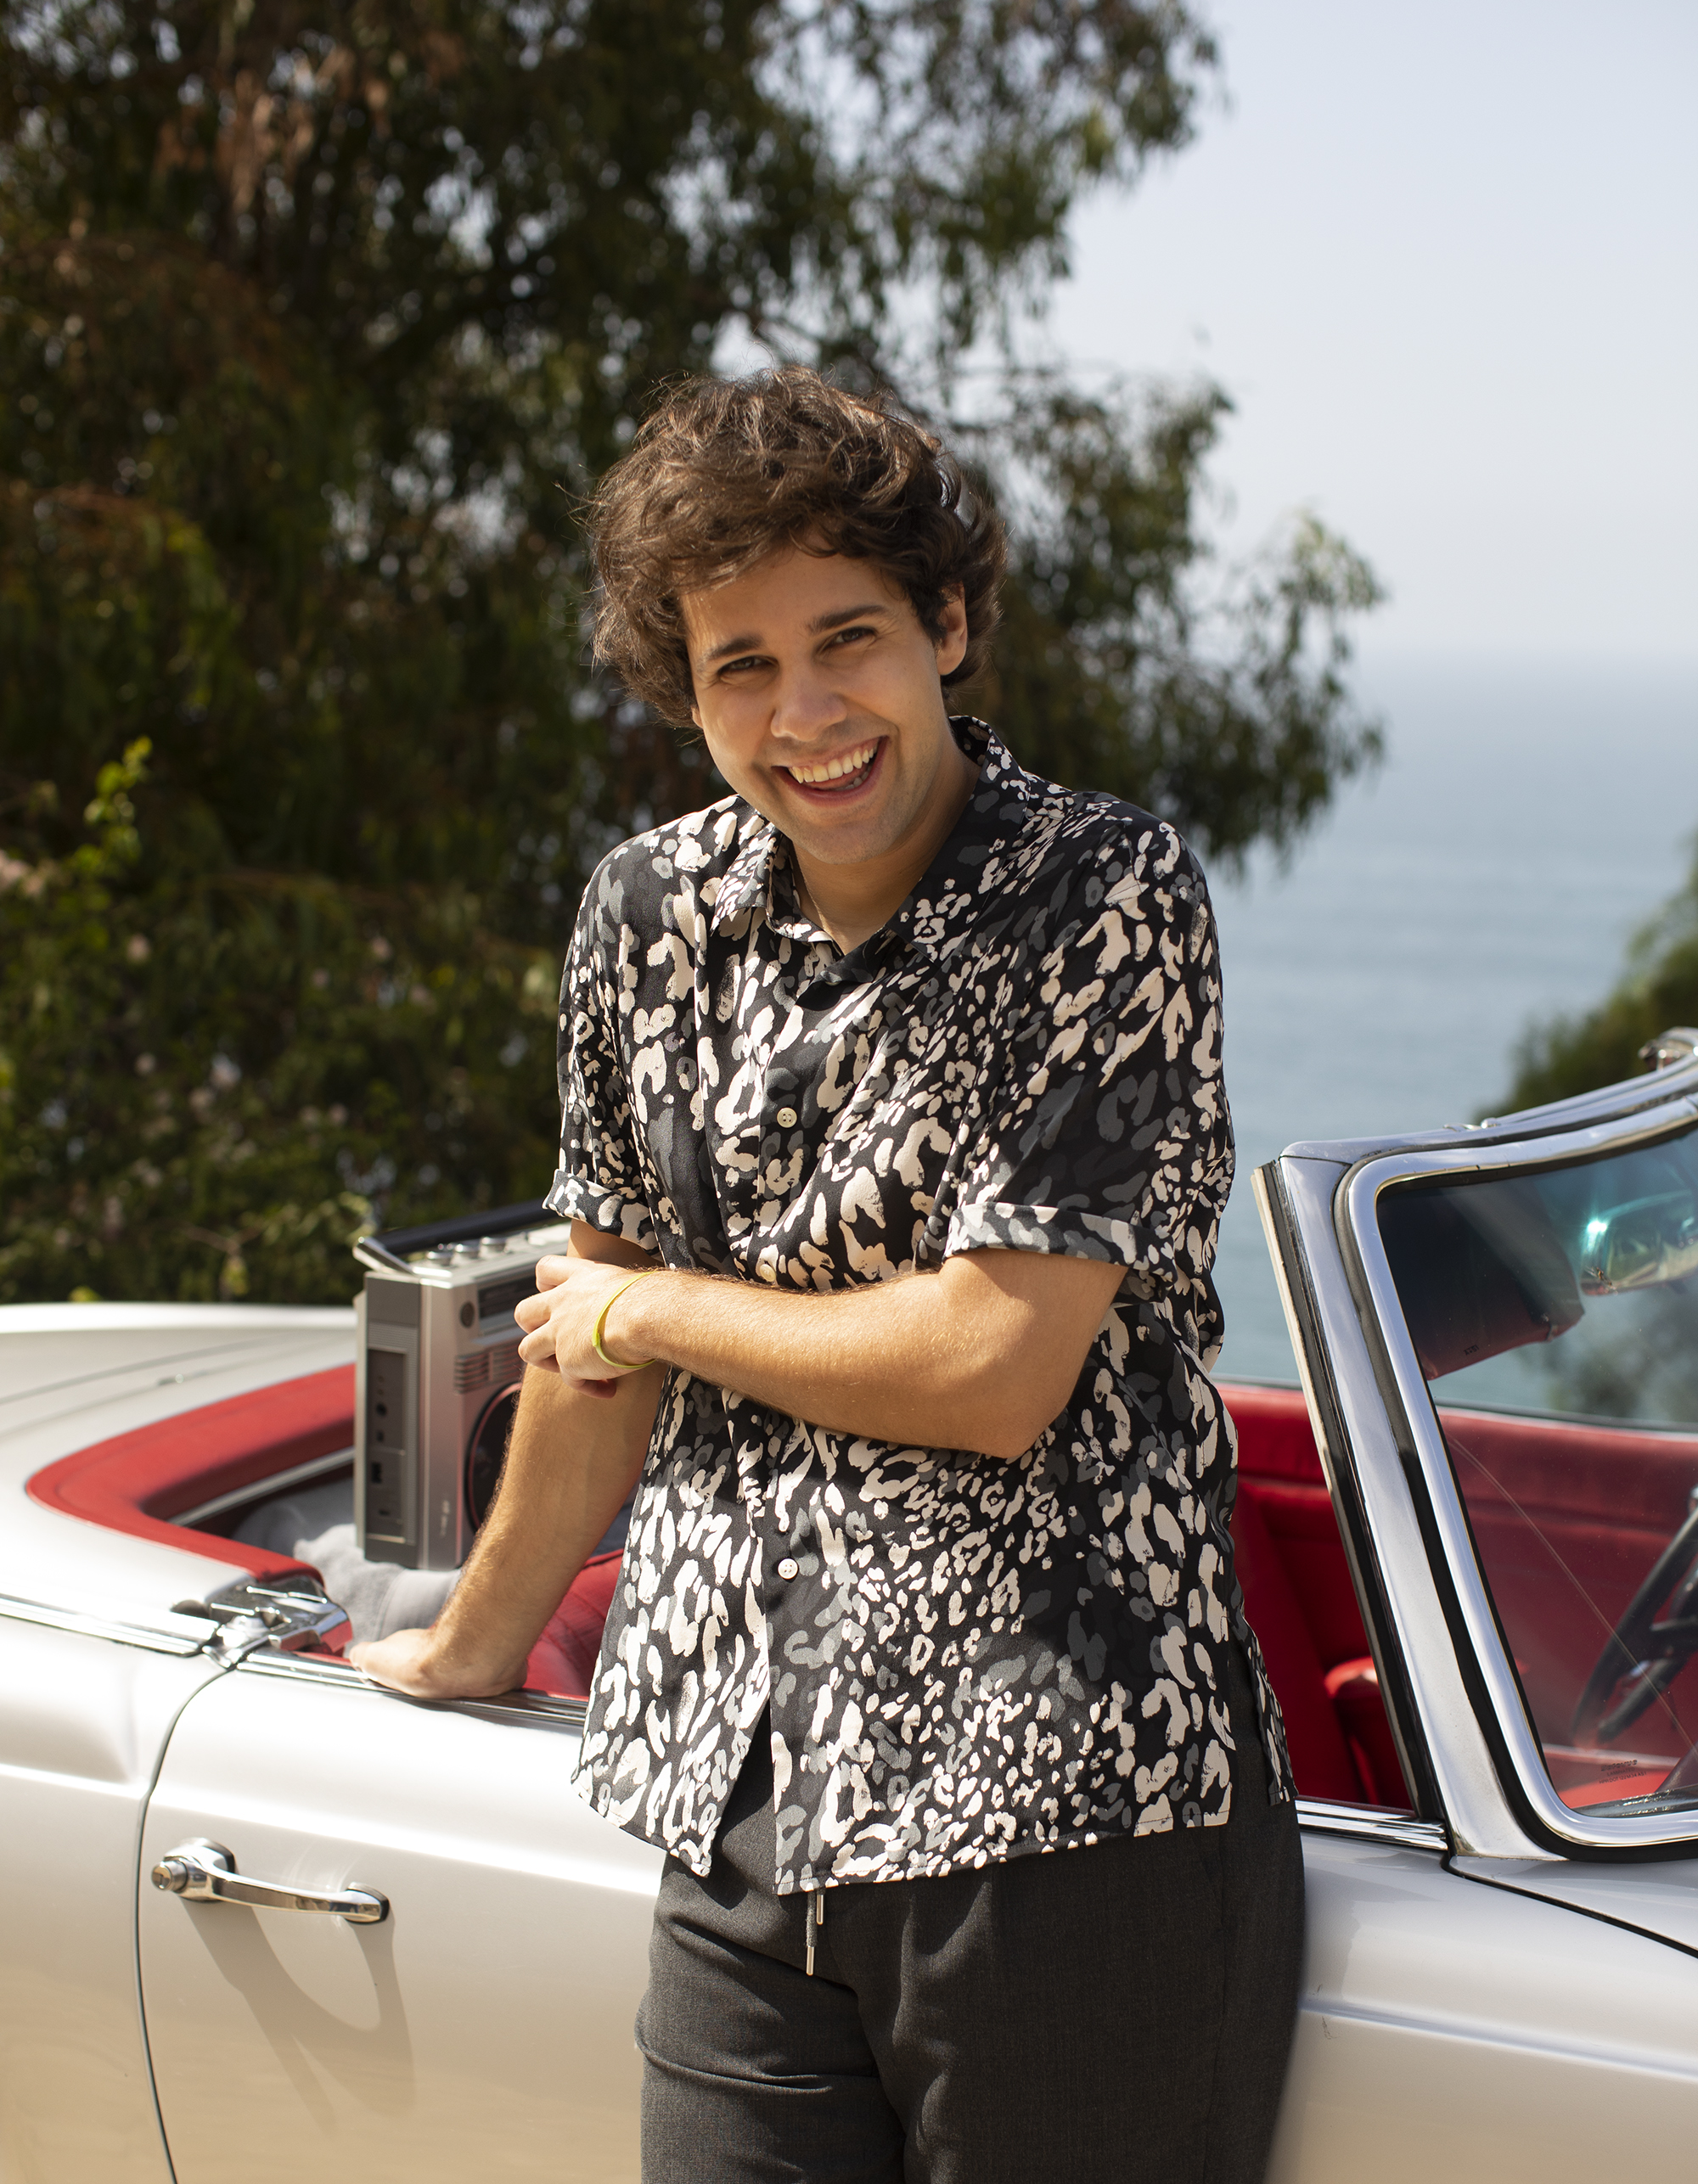
03
CONTRIBUTIONS

Slide 9
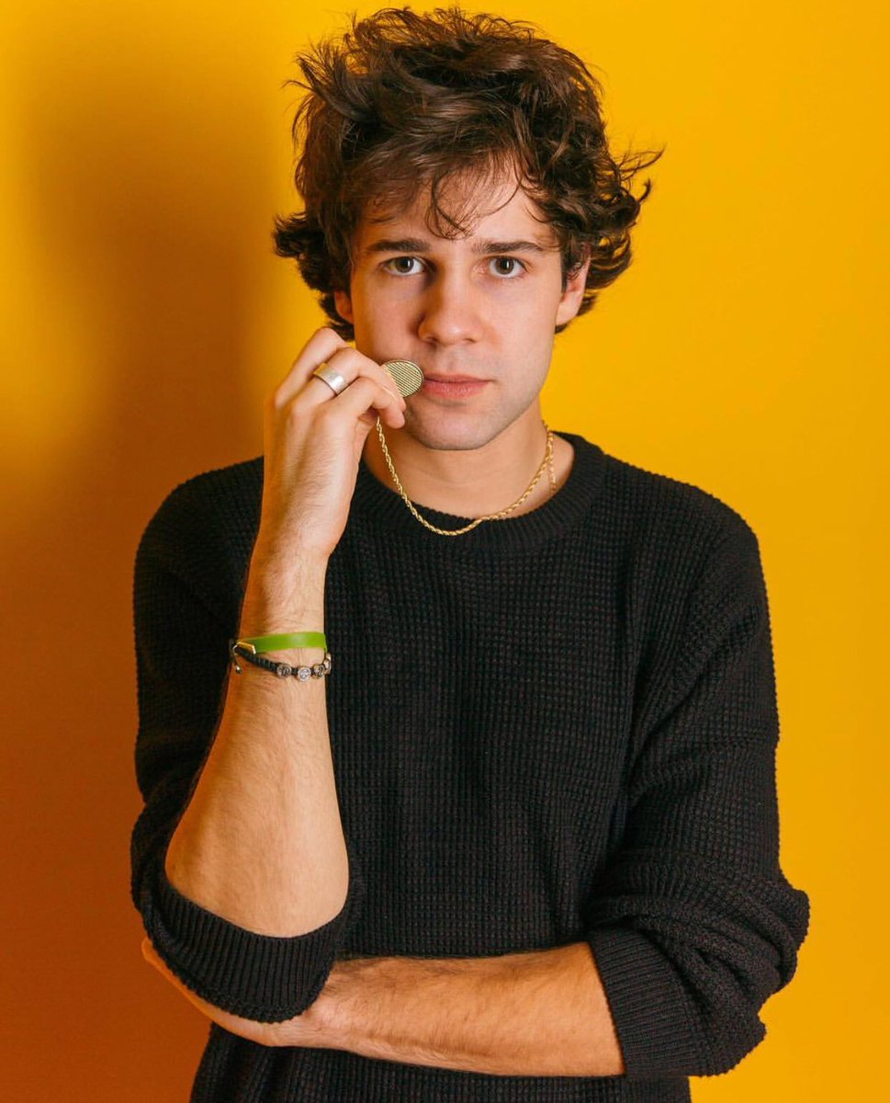
—DAVID DOBRIK
1. Donated $50,000.
2. Help homeless people.
3. Assist college students.

Slide 10
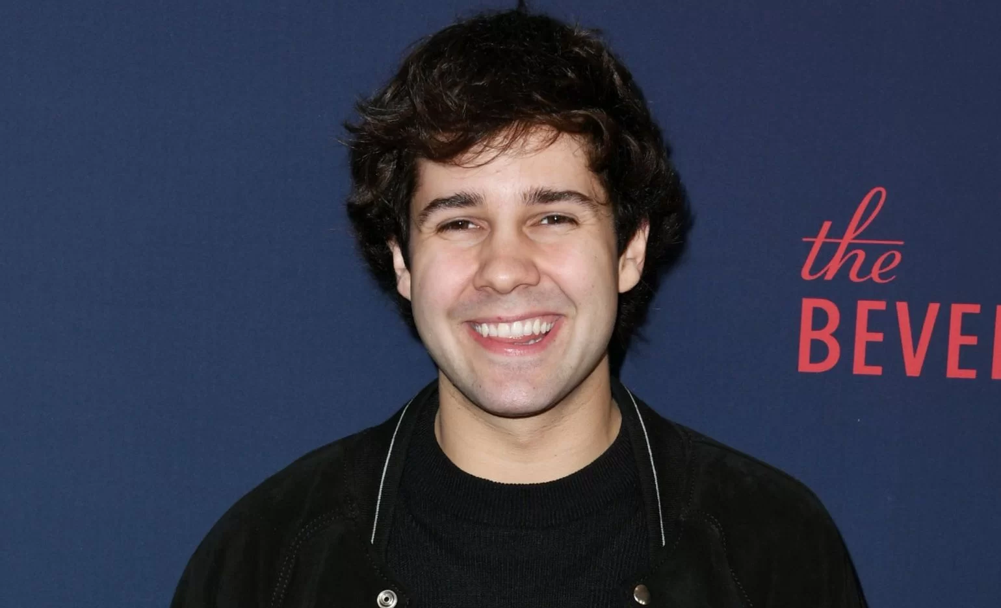
—DAVID DOBRIK
“Giving to someone is the most selfish thing you can do because it’s so easy to give back when you've been given a lottery ticket of a job.”

Slide 11
A BRIEF SUMMARY ABOUT DAVID DOBRIK
ACHIEVEMENT
CONTRIBUTION
BACKGROUND
YOUTUBER, TIKTOKER.
DIAMOND PLAY BUTTON AND AWARDS.
BE ALWAYS READY TO HELP.

Slide 12
REFERENCES
1. insider.
2.THE DAILY ILLINI.
3.SKWIKI
https://www.insider.com/youtuber-david-dobrik-donates-50000-to-black-lives-matter-causes-2020-6
https://dailyillini.com/showcase/2019/10/17/david-dobrik-shares-wealth-not-clickbait/
https://www.sportskeeda.com/tiktok-wiki/who-is-david-dobrik#who-is-david-dobrik-2
4.THE WIKIFEED
5.wikipedia
6.FORBES
https://www.thewikifeed.com/david-dobrik/
https://en.wikipedia.org/wiki/David_Dobrik
https://www.forbes.com/sites/tomward/2019/04/10/david-dobrik-never-stops-working/?sh=61b5f88d37f2

Slide 13
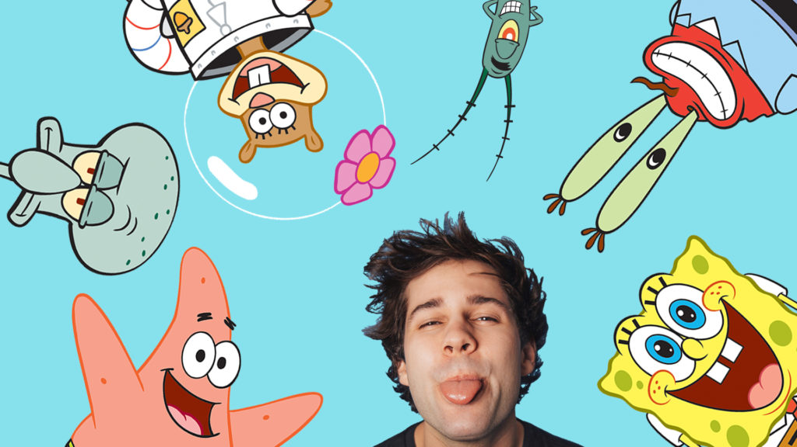
IT IS TIME FOR QUESTIONS.
THANKS.

Slide 14
DAVID DOBRIK NET WORTH
$10M
$13M
$17M
$20M
$25M
2017
2018
2019
2020
2021,2022

Slide 15
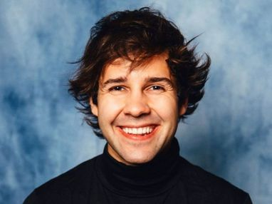
CONCLUSION
LET’S BREAK UP.

